Slide 1
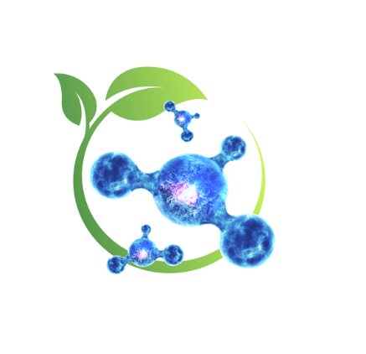
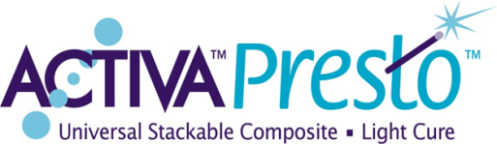
PULPDENT
®
Dental Innovation Since 1947
Introduces…Nature’s Magic in a Dental Composite

Slide 2
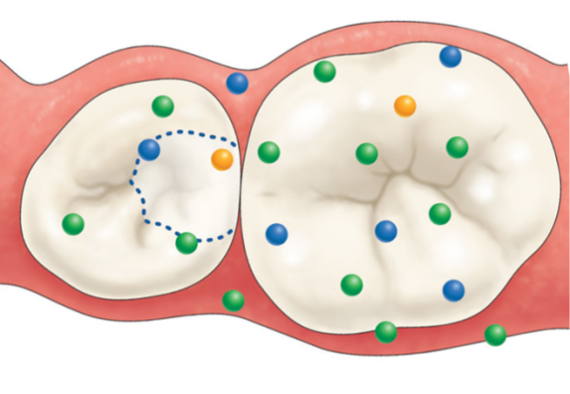
PULPDENT
®
Pulpdent continues to develop restorative products that mimic nature and support the natural remineralization process that protects teeth, Nature’s Way.
Presto’s moisture friendly ionic resin interacts with saliva and tooth structure and facilitates the exchange of calcium, phosphate, and fluoride ions that helps regulate the natural chemistry of teeth and promotes oral health.

Slide 3
PULPDENT
®
The first light cure composite designed to mimic the properties of natural teeth
Supports the slow, natural biomineralization process
High phosphate content
Two Fundamental Elements in ACTIVA Presto that Mimic Nature:
Moisture friendly ionic resin
Rubberized-resin - Tough, durable, wear and fracture resistant

Slide 4
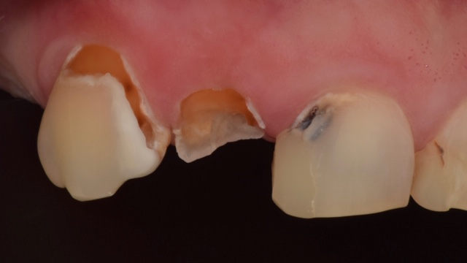
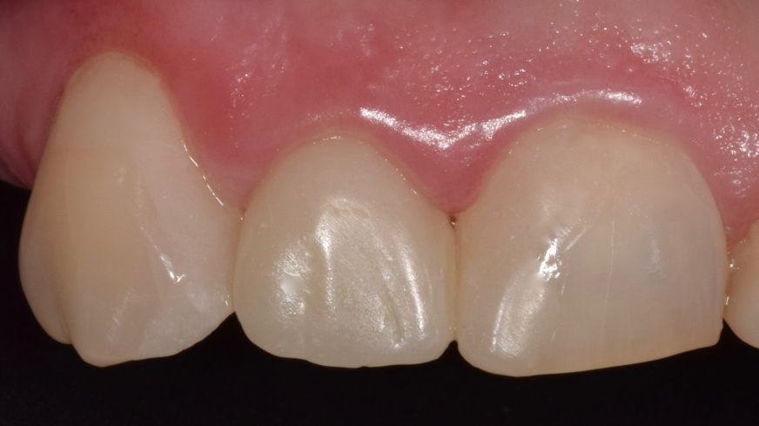
PULPDENT
®
The first light cure composite designed to mimic the properties of natural teeth
Highly esthetic
Indicated for load bearing applications
Indicated for all restorative procedures
Severe caries restored with Activa Presto A1 and A2 shade

Slide 5
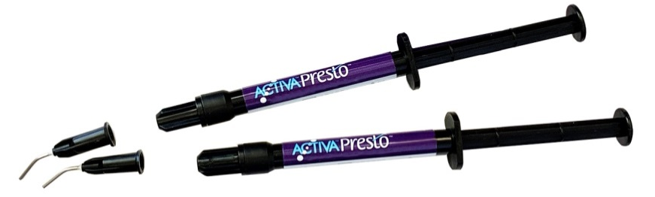
PULPDENT
®
-
KIT: 2 x 1.2mL/2 gm syringes + 20 applicator tips
- UNIVERSAL STACKABLE COMPOSITE, LIGHT CURE
Code Description List _
VPF1A1 A1 Shade $89.99
VPF1A2 A2 Shade
VPF1A3 A3 Shade
VPF1A35 A3.5 Shade
VPF1A4 A4 Shade
VPF1A6 A6 Shade
VPF1B1 B1 Shade
VPF1BW Bleach White Shade
Note: A4 and A6 are cervical shades
Applicator Tips .
19K20 19 ga x ½”, pkg. 20 $5.60
19K100 19 ga x ½”, pkg. 100 $23.45

Slide 6
PULPDENT
®
New User/Existing User Offers
Buy 1 ACTIVA PRESTO Kit - Get 1 FREE (limit 3 FREE)
Already using ACTIVA Presto?
Buy 3 ACTIVA Presto Kits - Get 1 FREE (no limit)

Slide 7
PULPDENT
®
Contact Us to Learn More
Judy Icardi – judy@pulpdent.com
Gale Hostert – ghostert@pulpdent.com

